Slide 1


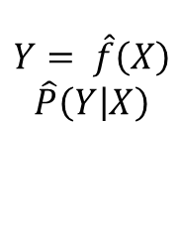

$$\left(x_{1},y_{1}\right),\left(x_{2},y_{2}\right),…,(x_{N},y_{N})$$
模型
学习系统
$$x_{N+1}$$
$$y_{N+1}$$
$$Y= \hat{f}\left(X\right)$$
$$\hat{P}\left(\left.Y\right|X\right)$$
预测系统

